Slide 1

Democratizing Access to Cryptocurrency Transactions

Slide 2

Content
1. Company Overview
2. Vision and Mission
3. Market Analysis
4. Technology and Security

Slide 3

Company Overview
Section 1

Slide 4

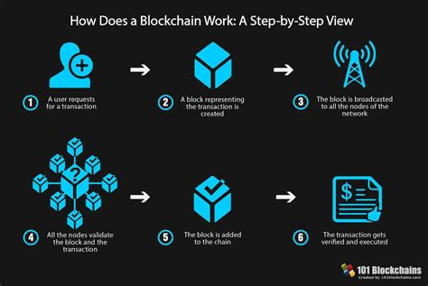

Background and Service Offering
Inspiration and Mission
Empowering the unbanked with accessible financial services through blockchain technology.
Becoming a utility for P2P, P2B, and B2B payments for crypto users tired of trusting traditional financial organizations.
Core Product
A decentralized wallet app for fast XRP transactions, with plans for expansion to other low-fee, fast cryptocurrencies for payments like XLM, DOGE, ALGO, etc.

Slide 5


Competitive Landscape and Revenue Model
Differentiation
Prioritizing user control, security, and speed to stand out in the market.
Revenue Model
Minimal fees for platform transactions, higher fees for external addresses, and an 80% revenue share from Changelly exchanges.

Slide 6

Vision and Mission
Section 2

Slide 7

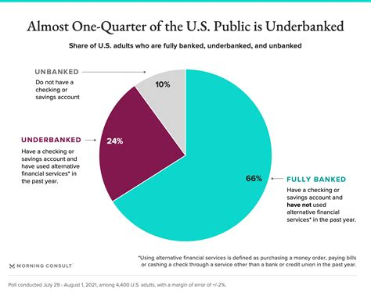
Vision for Inclusive Transactions
Global Reach
Leading platform for inclusive, fast, and secure global cryptocurrency transactions.
Target Audience
Unbanked, underbanked, and bank-averse populations in emerging markets

Slide 8

Funding Goals and Growth Projections
Initial Investment
Market expansion, technology development, operational costs, and hiring a CMO, CFO, and other leadership positions.
User Base Expansion
Strategic marketing and partnerships for increased market share.

Slide 9
Market Analysis
Section 3

Slide 10
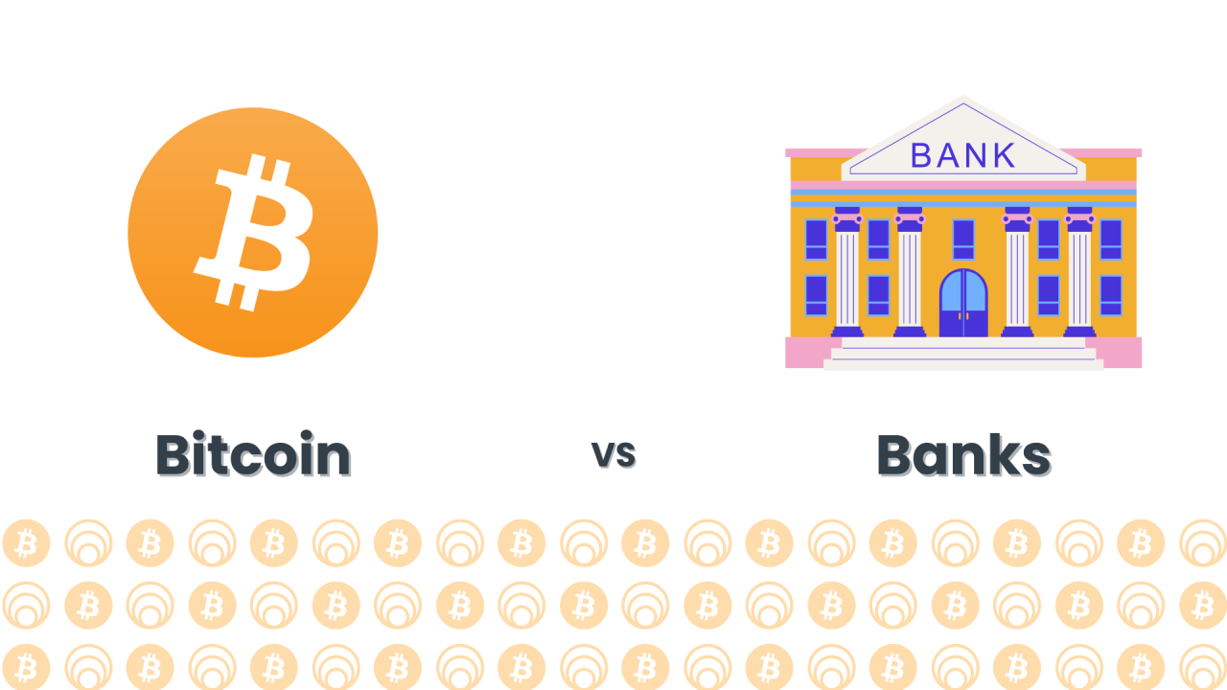

Market Needs and Competitive Landscape
Market Needs
Secure, fast, and accessible financial transactions without traditional banking infrastructure.
Differentiation
Prioritizing user control, security, and speed to stand out in the market.

Slide 11

Future Services and Revenue Model
Expansion Plans
Support for additional cryptocurrencies, explore B2B payment solutions, and potentially eliminate internal transaction fees.
Revenue Streams
Minimal fees for platform transactions, higher fees for external addresses, and an 80% revenue share from Changelly exchanges.

Slide 12
Technology and Security
Section 4

Slide 13


Technology Stack
Backend
DynamoDB, Express.js, Node.js
Frontend
React Native for cross-platform usability.
01
02

Slide 14


Security Features
Encryption
Advanced AES encryption and sharded keys for maximum security of user funds.
Partnership
Collaboration with Changelly for secure currency exchanges.

Slide 15

Thank You
Contact: devanshpatel22@gmail.com

